Slide 1
Introduction to Constructive Technology Assessment
Klaasjan Visscher & Peter Stegmaier,
(With help of Haico te Kulve)
University of Twente
EU MACS Kick-off
24 November 2016

Slide 2
AGenda
PART 1: Intro CTA
  What is (C)TA?
  Why do CTA?
  How to do CTA?
PART 2: CTA in EU MACS
  Relation to other methods
  Expectations
  Identification of critical issues
PART 3: Getting started
  Imagine the future

Slide 3
What is Technology Assessment?
“The main meaning is the early identification and assessment of eventual impacts of technological change and applications, performed as a service to policy making and decision making more generally.” Rip (2015)
Variety of approaches (Rip 2015)
  “Picking the winners” by firms and technology institutes
  Impact analysis: environmental impact statements, medical TA
  Interactional TA, such as Constructive TA

Slide 4
Trilemma of analysis and steering:
Knowledge? Control? preferable directions?
Early stage: less knowledge, much control potential
Late stage: more knowledge, less control potential
+
Early stage: uncertainty about directions of preferable technology development and use, and impacts of technologies
Late stage: preferred directions become clear, little room to change directions
Control of technology
Knowledge of impacts
Evaluation of preferable directions
Embedding of technology in society

Slide 5
CTA Diagnosis of the Trilemma
No ‘either control, or impact, or direction’: ongoing processes!
  So: ongoing assessment of what is happening, and should be happening
A division of labour regarding technology development & assessment
  Technological change is carried & pushed by promoters (“enactors”).
  Other actors such as regulators, funding agencies, policy makers, clients, users and interest groups choose/select between alternative technological options (“selectors”)

Slide 6
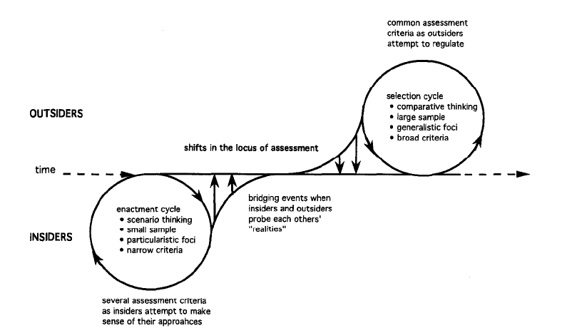
Enactors and selectors: different patterns in assessing novel technological options
Those who ‘select’ new options
(selectors)
Those who create and ‘enact’ new options (enactors)
Dynamics in the Constitution of the Technological Field
Garud and Ahlstrom 1997
Notes:
Technology developers and promoters try to realize (enact) new technology, construct scenarios of progress and consider obstacles mainly as something to be overcome
Focus on the promise, and tend to disqualify opposition as irrational or misguided, or following own agendas
Enactors see the world as waiting to receive their technology.
While “the world” / selectors see alternatives
And are likely to apply different or broader criteria for evaluation

Slide 7
PosItion of Constructive Technology Assessment
Those who ‘select’ new options
(selectors)
Those who create and ‘enact’ new options (enactors)
Dynamics in the Constitution of the Technological Field
Garud and Ahlstrom 1997
Notes:
Bridging events constitute linkages between enactment and selecting cycles, which may institutionalize. Bridging events can be constructed on purpose, by actors from enactor or selector positions, and by more disinterested actors such as Constructive Technology Assessment (CTA) agents and macro-alignment actors (Rip 1995), who are stimulating reflexive interactions between variation and selection processes.

Slide 8
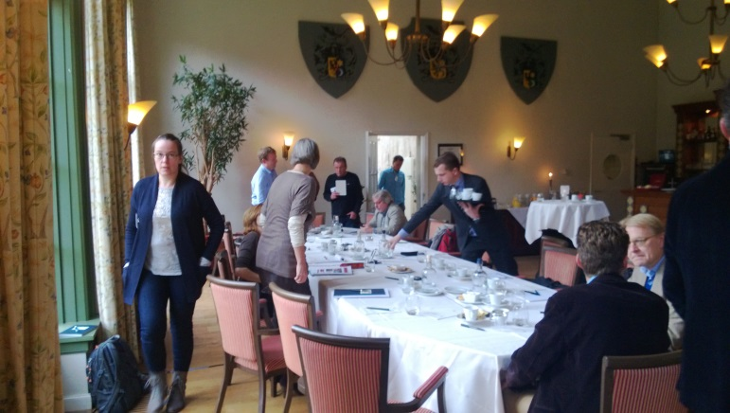
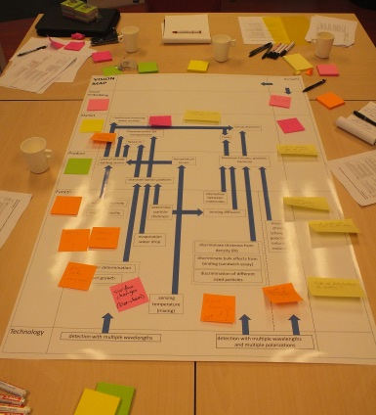
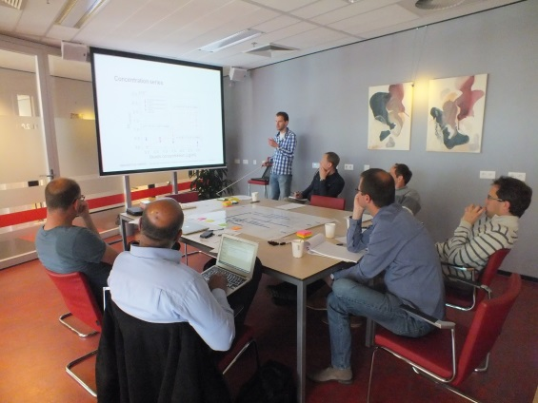
Bridiging Events: Major focus of CTA events
General approach of Constructive Technology Assessment: orchestrate and support bridging events between enactors and selectors
No need to go for consensus: actors have different perspectives and will learn different things
CTA workshop: micro/nano-enabled sensors for water and food applications
Multi-path mapping exercise: Young interferometer for sensing applications (RATA project)

Slide 9
A typical CTA exercise
Set-up
Objectives
Scenarios
Analysis (pre-engagement)
Workshop organization
Based on analysis
Exploring possible actor strategies
Follow up
Evaluation
New actions
Workshops
Interactive discussions
Analysis of ongoing and future developments
Strategy formulation

Slide 10
Part 2: CTA in EU MACS
A CTA based multi-layer perspective on CS markets and a suite of “interactional formats” to feed stakeholder engagement in WP2-WP4

Slide 11
Multi-level-perspective (rip 2012)
Socio-technical scenarios
PESTEL
Living labs

